Slide 1
Generalized Overlapping Group Lasso for Patients Subgroups Selection
Wenxuan Deng

Slide 2
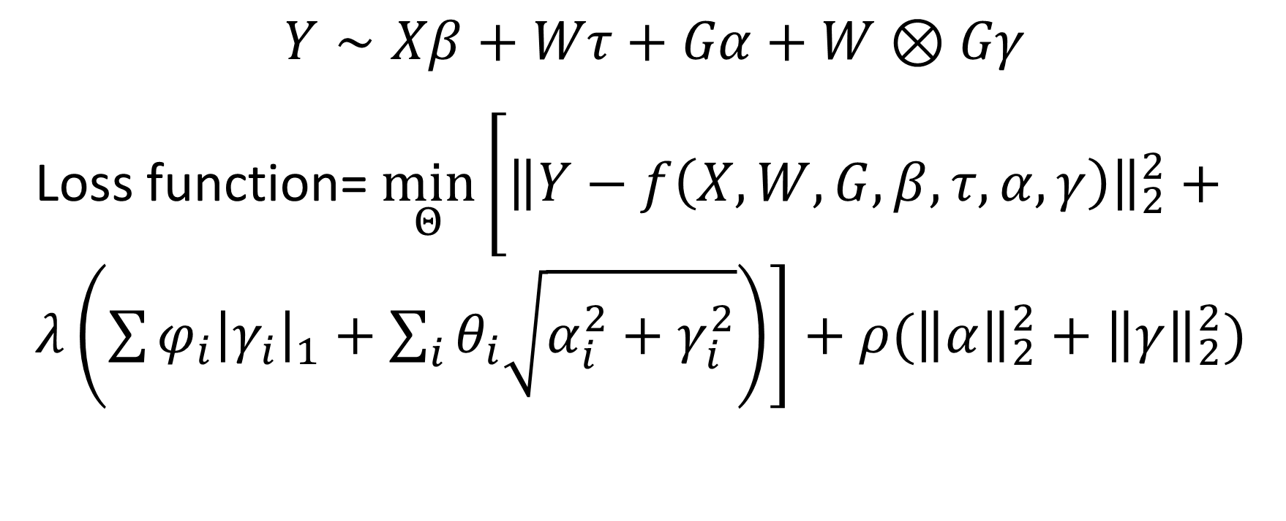
Model
Baseline Variable
Main/Interaction Effects of Genes
Treatment Variable
$$Y∼Xβ+Wτ+Gα+W⊗Gγ$$
Loss function= $\min_{Θ}\left[{\left\|Y−f\left(X,W,G,β,τ,α,γ\right)\right\|}_{2}^{2}+λ\left(\sum{φ_{i}{\left|γ_{i}\right|}_{1}}+\sum_{i}{θ_{i}\sqrt{α_{i}^{2}+γ_{i}^{2}}}\right)\right]+ρ({\left\|α\right\|}_{2}^{2}+{\left\|γ\right\|}_{2}^{2})$

Slide 3
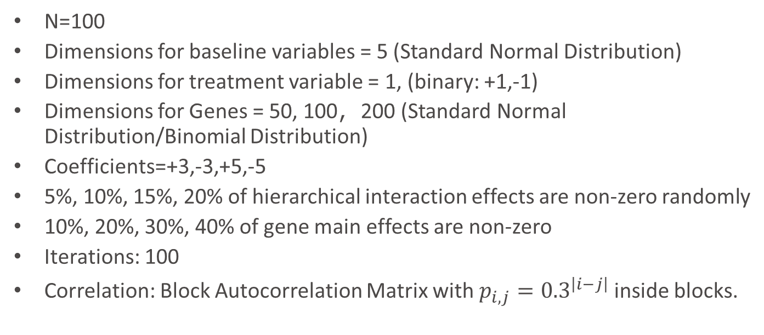
Simulation Setup
N=100
Dimensions for baseline variables = 5 (Standard Normal Distribution)
Dimensions for treatment variable = 1, (binary: +1,-1)
Dimensions for Genes = 50, 100，200 (Standard Normal Distribution/Binomial Distribution)
Coefficients=+3,-3,+5,-5
5%, 10%, 15%, 20% of hierarchical interaction effects are non-zero randomly
10%, 20%, 30%, 40% of gene main effects are non-zero
Iterations: 100
Correlation: Block Autocorrelation Matrix with $p_{i,j}={0.3}^{\left|i−j\right|}$ inside blocks.

Slide 4

Signal/Noise ratio
For 100 genes: 1, 5, 10, 100.
$SNR=\frac{var(y_{0})}{var(ε)}$, where $y=y_{0}+ε$

Slide 5
Other methods
General Lasso without penalizing baseline and treatment variables (Lasso)
Bayesian Model Averaging (BMA)
Stepwise Variable Selection by likelihood (step)
Iterative Sure Independent Screening (SIS)

Slide 6
Proportion of nonzero interactions

Slide 7
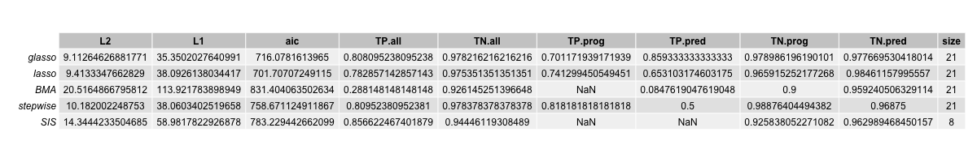
Nonzero Interaction Effects Proportion=0.05

Slide 8
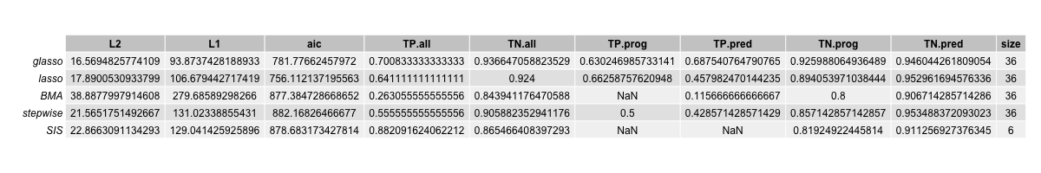
Nonzero Interaction Effects Proportion=0.1

Slide 9
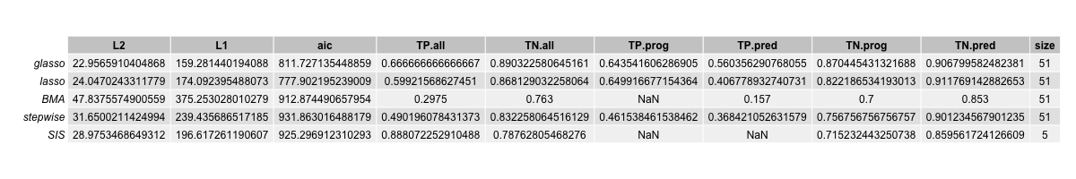
Nonzero Interaction Effects Proportion=0.15

Slide 10
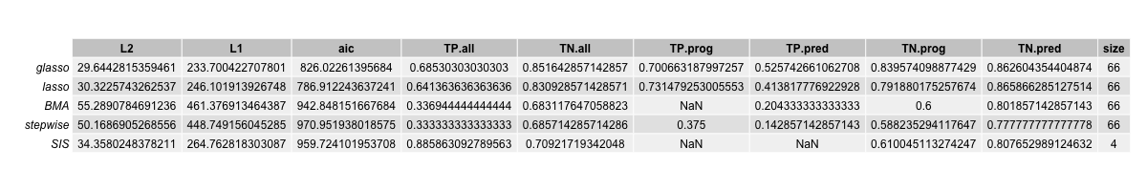
Nonzero Interaction Effects Proportion=0.2

Slide 11
SNR

Slide 12
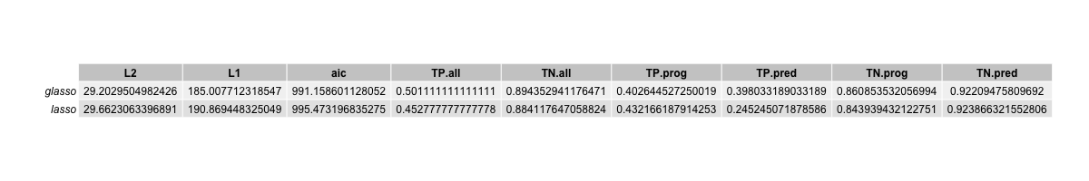
SNR=1

Slide 13
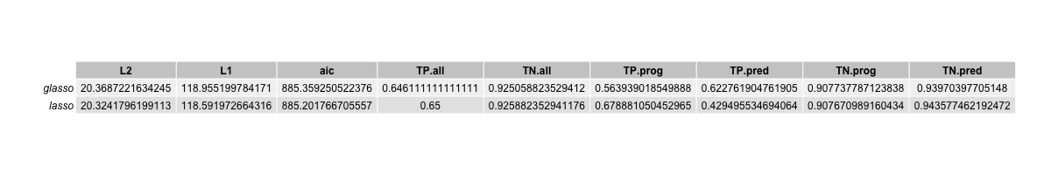
SNR=5

Slide 14
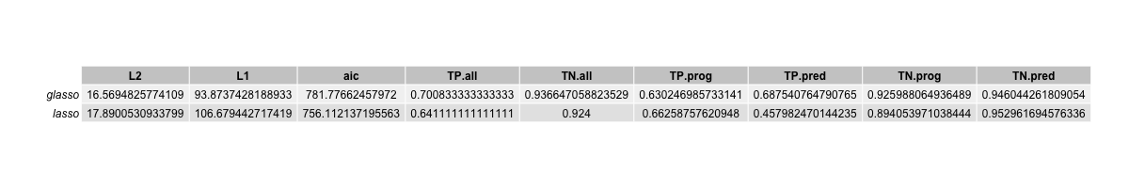
SNR=10

Slide 15
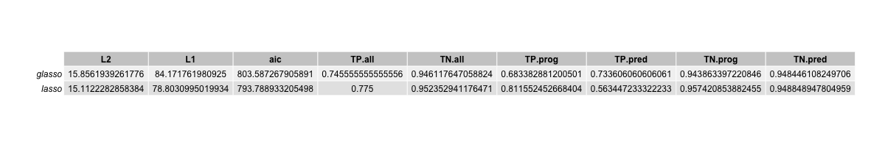
SNR=100

Slide 16
When p=2n

Slide 17
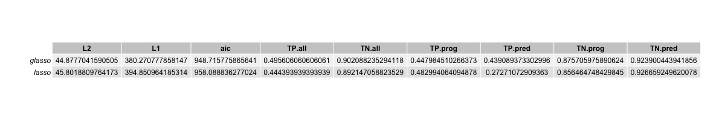
Dimension of genes=200 and total dimension=406

Slide 18
When covariates are SNP

Slide 19
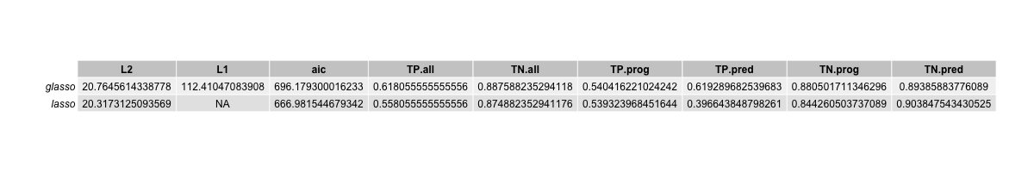
SNP

